Slide 1
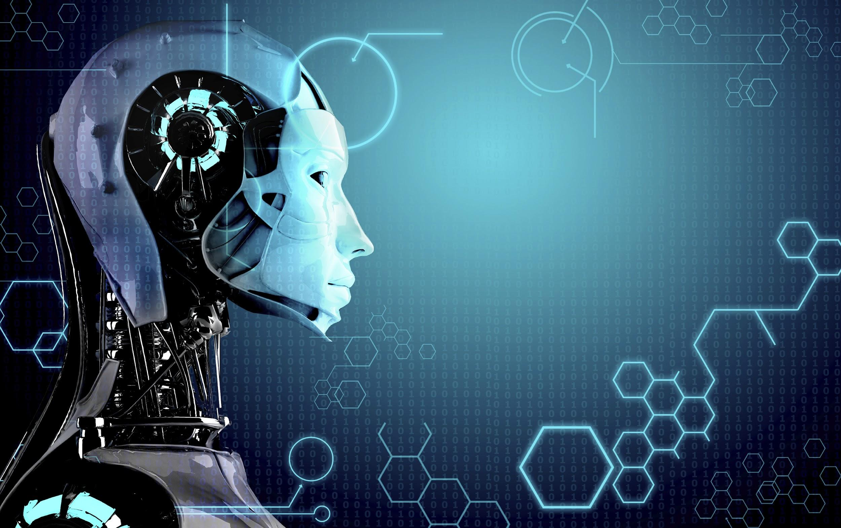
FACEMASK DETECTION USING TRANSFER LEARNING

Slide 2
TEAM MEMBERS
NAME ROLL NO
RUDRASISH MISHRA 1906649
ANSHUMAN SAHU 1906678
ANTARIKSH CHOUDHARY 1906014
ABHISHEK KUSHWAHA 1906674

Slide 3

ABSTRACT
The outspread of the corona virus types has caused pandemic across the globe.The virus is known for severe acute respiratory issues. The ailment it causes is called coronavirus disease 2019 or (COVID-19) affecting our day-to-day life disrupting world trade and movements. Wearing a mask is one of the effective methods to prevent us from being affected by the vicious COVID virus.This project titled Face Mask Detection has been developed using a machine learning technique known as transfer learning and by using image classification method of MobileNetV3small .Steps followed while building the model are data collection, data preprocessing , data splitting , model-rectification ,model testing and model implementation.

Slide 4
INTRODUCTION
This project introduces facemask detection in three phases, training, testing and finally the deployment of the model.In the training phase trained dataset using two classes with-mask and without-mask using transfer learning, tensorflow and OpenCV with the help of an image classification method : MobileNetV3Small which is the third version of the architecture empowering image analysis developed by google.In the testing phase the developed model is tested using an image to examine the accuracy finally model is mounted to detect mask on human face using embedded devices that could reduce the cost of manufacturing in such face mask detection systems hence we chose this architecture.
There is no proper structured face mask detection system, hence that increases the demand for an efficient system to predict face masks on human faces at various locations like, densely populated areas, Enterprises ,residential localities to ensure public safety. The built model can be directly implemented on CCTV surveillance cameras to impede the spread of the fatal COVID-19 virus by predicting if the individuals are wearing or not wearing a facemask. This system can help the authorities to keep a check on the localities that require more attention as well as maintain law and order and take initiatives in order to prevent the transmission of the lethal virus.

Slide 5
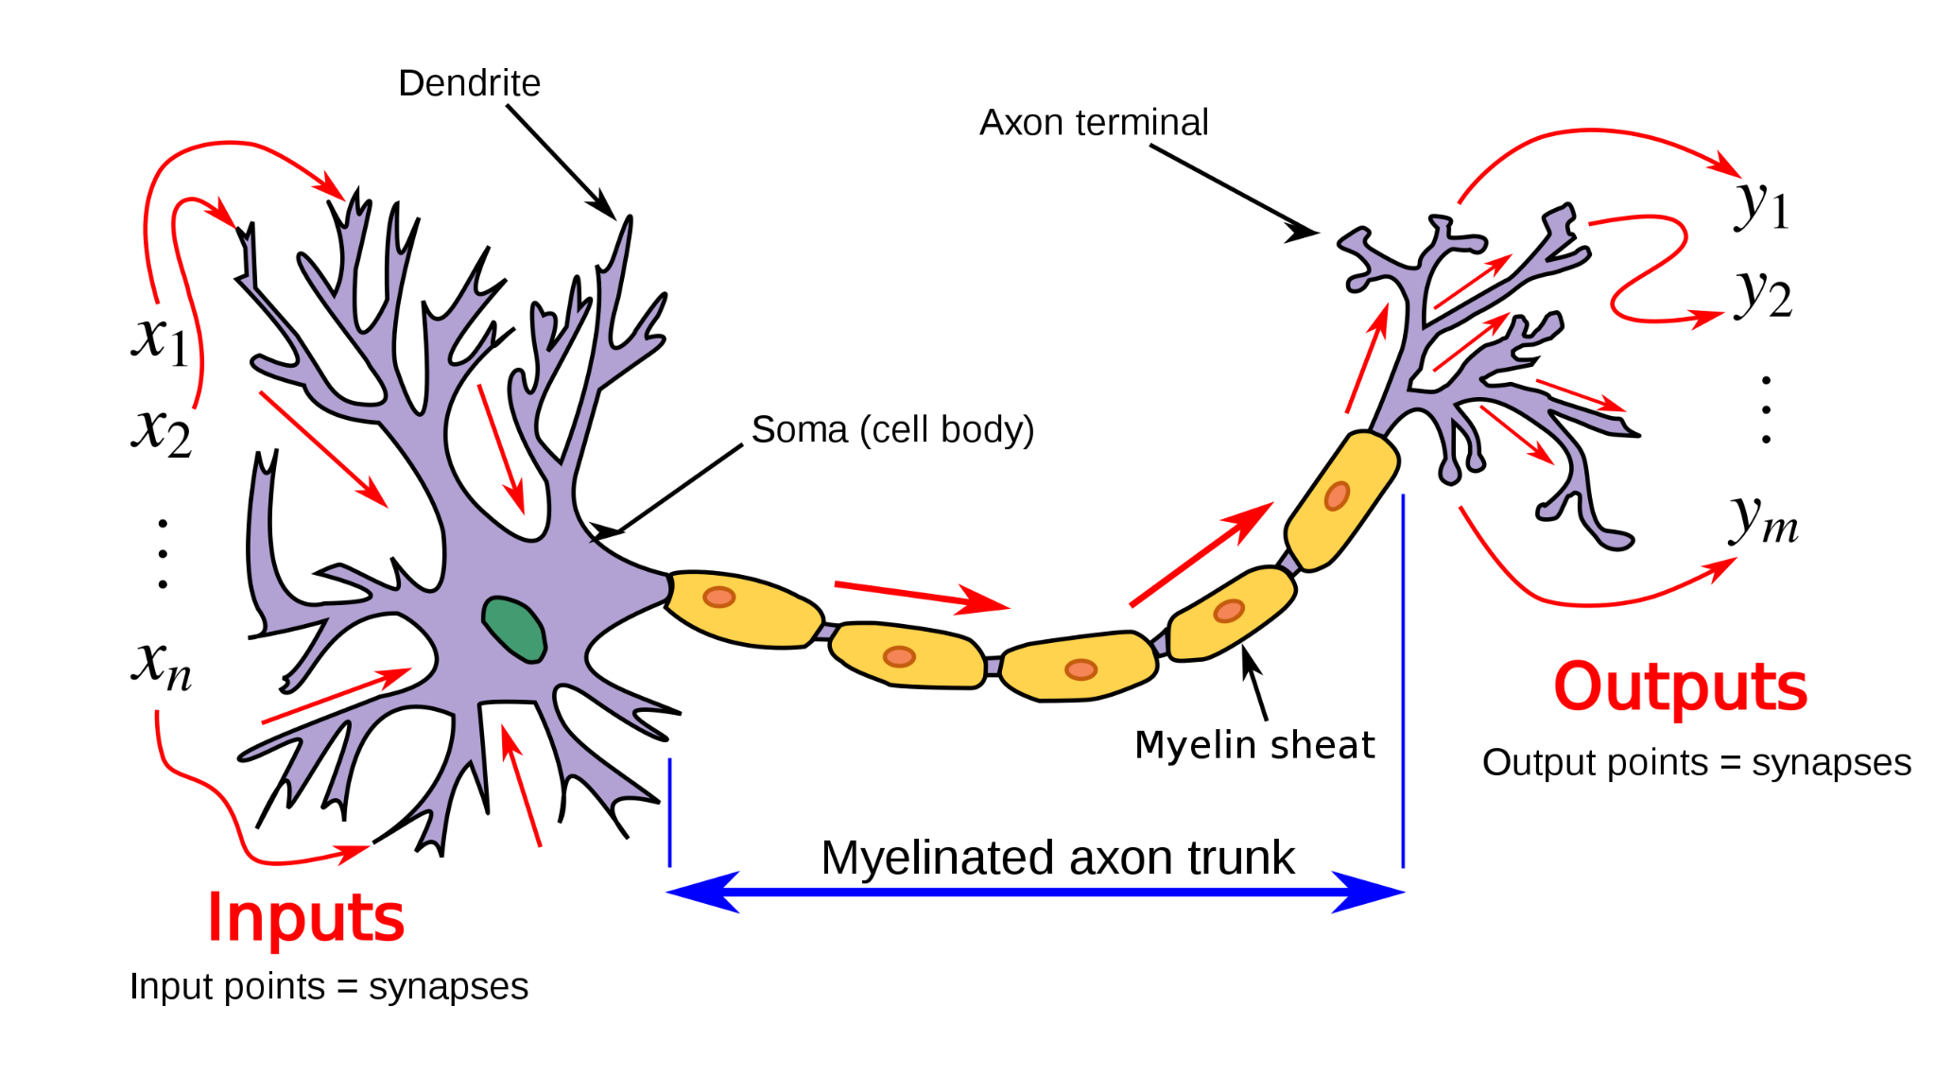
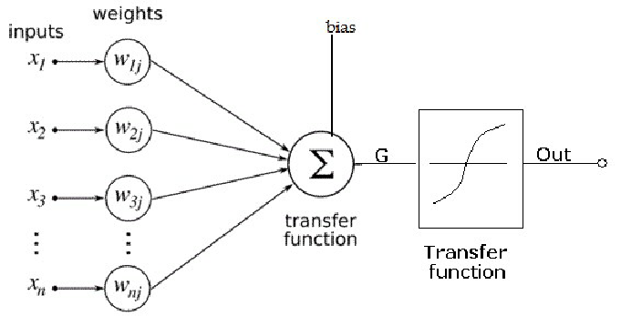
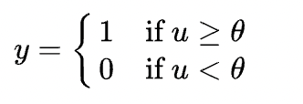
NEURON
Artificial neurons are designed to mimic aspects of their biological counterparts.

Slide 6
NEURAL NETWORKS
Perceptron
Feed Forward Neural Network
Multilayer Perceptron
Convolutional Neural Network
Radial Basis Function Neural Network
Recurrent Neural Network
LSTM –Long Short-Term Memory
Sequence to Sequence models
Modular Neural Network

Slide 7
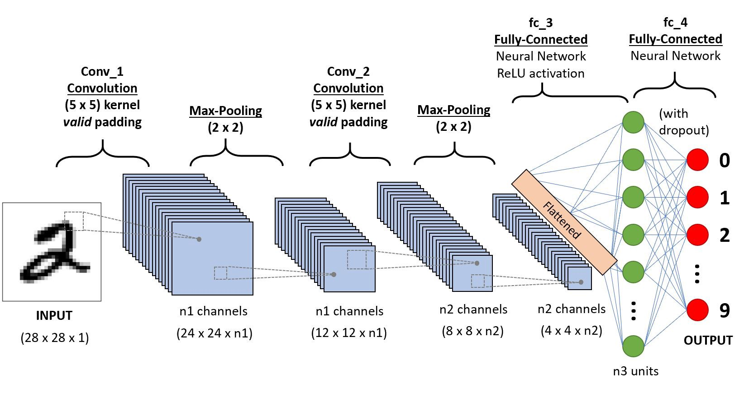
CNN
A CNN architecture is formed by a stack of distinct layers that transform the input volume into an output volume through a differentiable function. A few distinct types of layers are commonly used.
1.Convolutional layer
2.Pooling Layer
3.ReLU layer
4.Fully connected layer
5.Loss layer

Slide 8
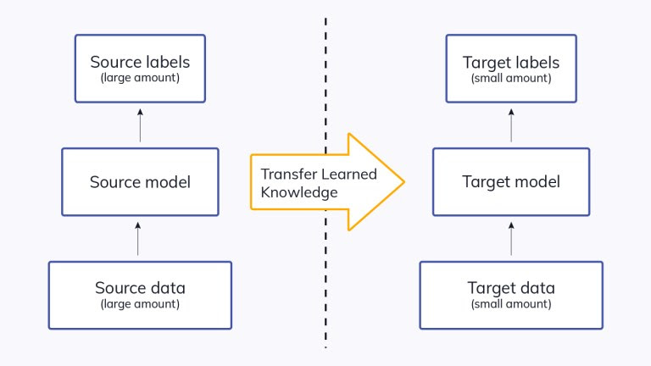
TRANSFER LEARNING
Transfer Learning is a machine learning method where we reuse a pre-trained model as the starting point for a model on a new task.
To put it simple as a model trained on one task is repurposed on a second, related task as an optimization that allows rapid progress when modeling the second task.
By applying transfer learning to a new task, one can achieve significantly higher performance than training with only a small amount of data.
Transfer learning is so common that it is rare to train a model for an image or natural language processing-related tasks from scratch.

Slide 9
LIBRARIES USED
1.Tensorflow
2.Keras
3.Numpy
4.Matplotlib
5.SciKit Learn
6.OpenCV

Slide 10
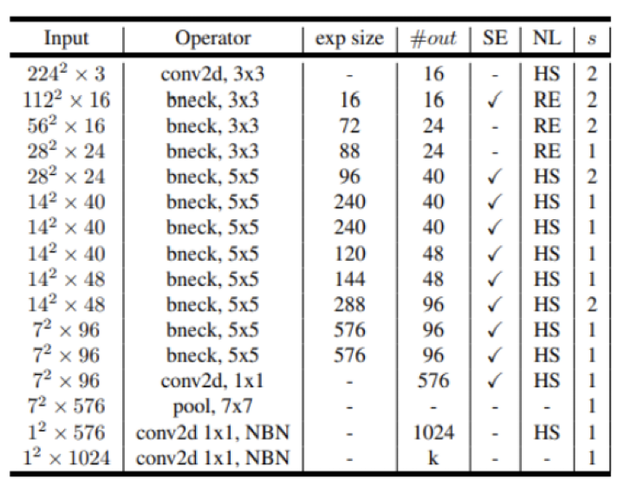
MOBILENETV3
MobileNetV3 Small is the third version of the convolutional neural network architecture that supports image analysis developed by Google. It targets low resource expenditure and is 6.6 percent more accurate as compared to a MobileNetV2 model. It is tuned to work efficiently with mobile phone CPUs through a mixture of hardware aware NAS complemented by the NetAdapt algorithm that automatically adapts a pre-trained deep neural network to a mobile platform and then sequentially enhanced through numerous enhancements. We used MobileNetV3Small model as it is faster than its counterparts in predicting if an individual is wearing or not wearing a mask.We removed the last layer of the model replaced it with an average pooling layer ,a system with a network of 128 layers, an activation function ‘relu’ and a dropout of 0.5 followed by another system with 2 layers that signifies the two classes that we used as labels.

Slide 11
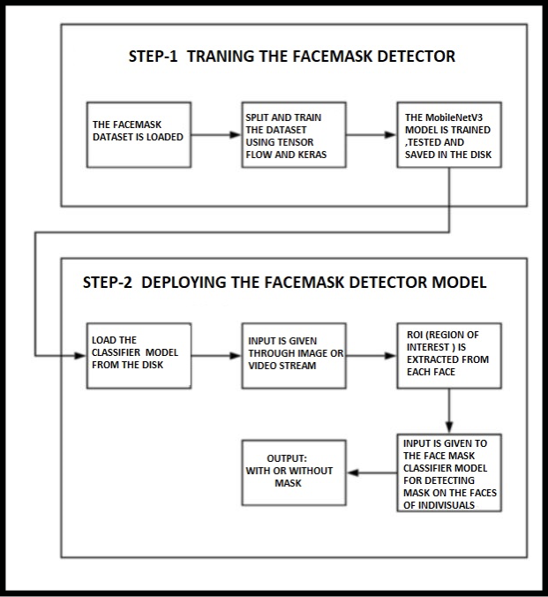
PROCEDURE/METHODOLOGY
Data collecting
Data pre-processing
Splitting the data
Building the model
Testing the model
Deploying the model.

Slide 12
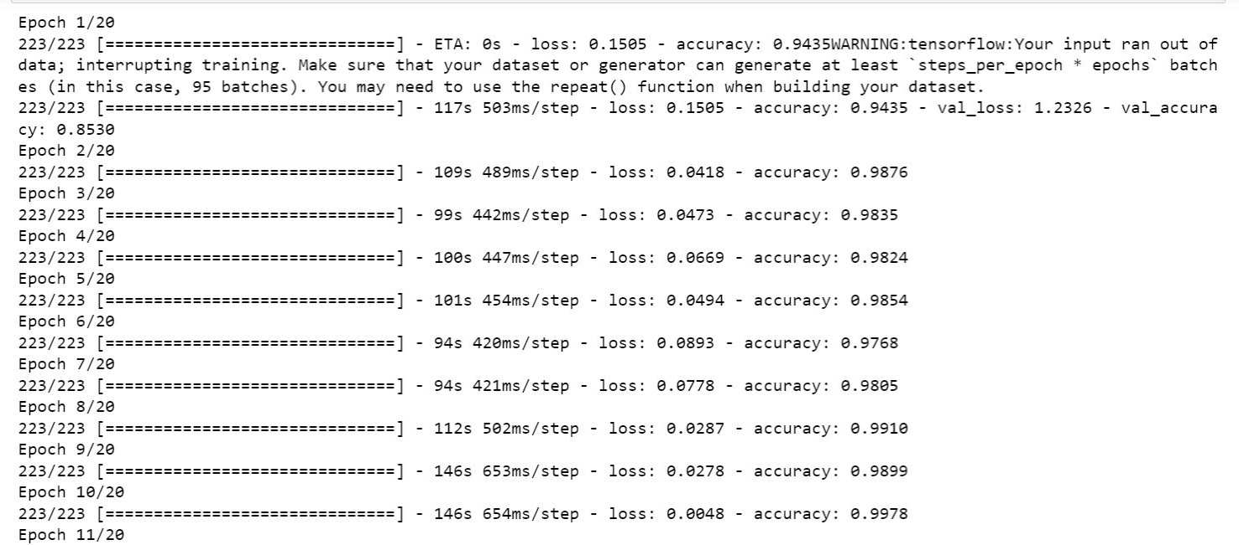
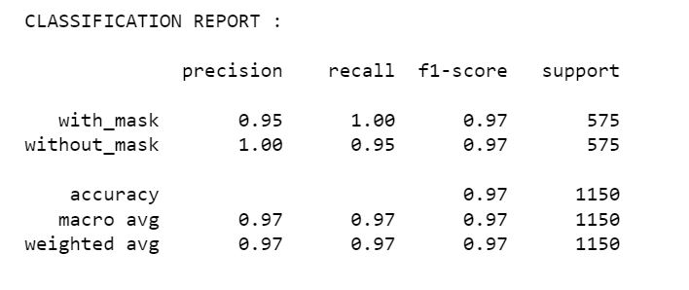
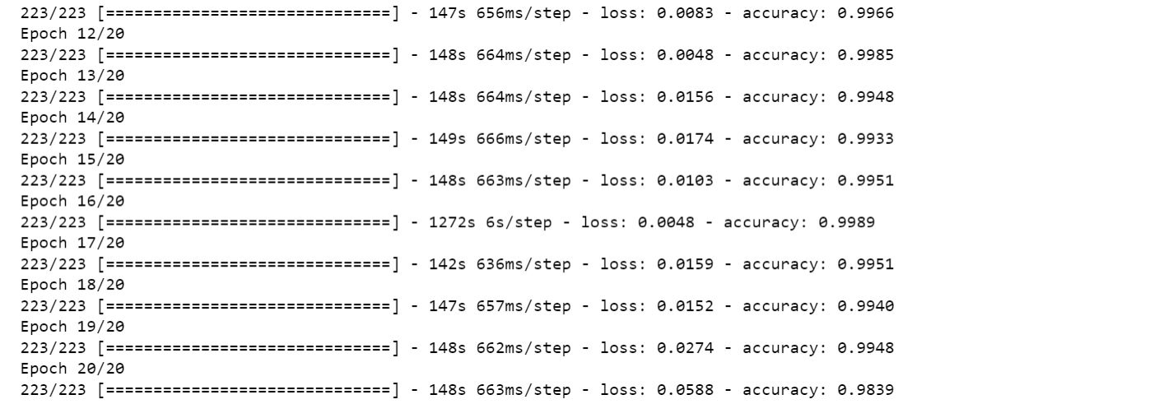
RESULTS

Slide 13
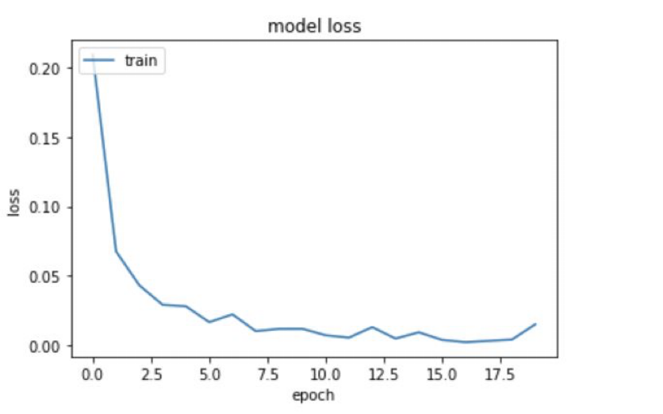
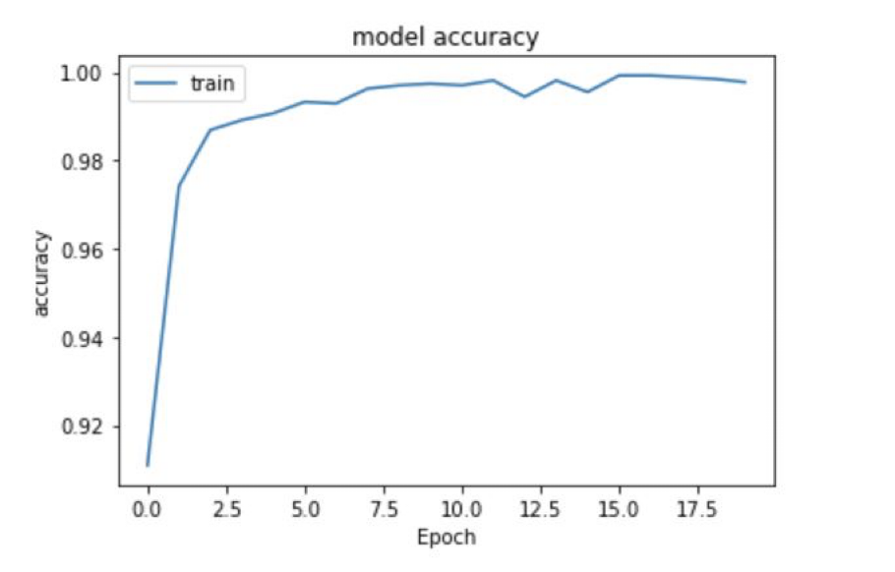
GRAPHS
FIGURE :Model accuracy and loss graph during training phase.

Slide 14
IMAGE TESTING
The trained model is deployed and the caffemodel is used. CaffeModel was created by Caffe and is a machine learning model that is used for image classification or image segmentation and has been trained using Caffe (convolutional architecture for fast feature embedding) and is implemented as well as created using prototxt files.A image containing human faces with or without mask is given as an input and it is sent to the face detector module for the detection of human faces. This is done by resizing the image and by detecting the binary large object in it. Then the binary object is sent to the default face detecting model which segments the image and gives output as the cropped face of a person.
In the next phase input data is predicted from the saved model and the output of the model is given to the pre-trained model of MobileNetV3 which determines whether the individual in the picture is wearing a facemask or not.

Slide 15
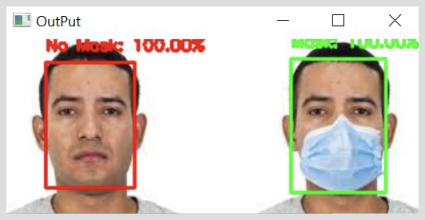
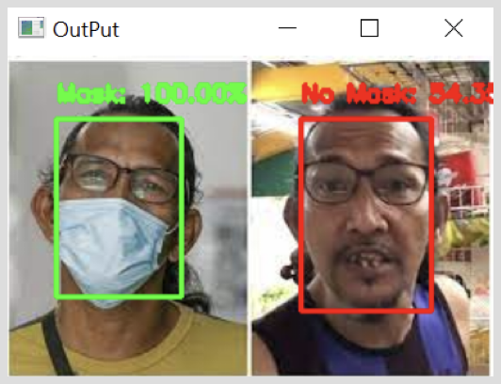
RESULTS

Slide 16
VIDEO
Finally the model is implemented in the video by using OpenCV,caffemodel and our pre-trained and saved MobileNetV3Small model. When an input video is given to the CV2 model,from frame to frame , then the face detection algorithm works. and detects facemask masks on the individuals. In the next phase input data is predicted from the saved model and a bounding circle is drawn around the face of the person that predicts whether the person is wearing a mask or not. . The video frame will also classify whether the person is wearing a mask or not.

Slide 17
CONCLUSION
With the help of this project we explained the facemask prediction system using MObileNet V3Small and we studied the functioning of various model like ResNet 101, VGG16 and MobileNetV2 but we implemented our project using MobileNetV3Small image classifier with an accuracy of 98.39 percent with the help of libraries like tensorflow, keras, opencv, numpy, imutils and matplotlib.
The implemented model will contribute enormously to the public health care system by predicting the presence of masks on the faces of the individuals and will restrict the spread of the deadly virus. It will act as an human alternative for detecting masks on human faces thus making the lives more convenient. It will also inform about the person who is not wearing a facial mask that is a precautionary measure of in the outset of COVID-19 to encourage people to wear their mask and make it an habitual activity.

Slide 18
FUTURE OUTLOOK
In the future we propose a system in which the violators will get a notification for not wearing facemask and the rules to be followed through SMS or email. This would work in a way such that cameras would detect a person’s face and generate a case identification number to identify that person with incorporation of IoT devices which will also help in the notification alerts , and rest of the action is taken care by the government personnels.
This model can further be used in organisations and enterprises to ensure that employees are wearing their masks and also to identify their presence for the day. For an individual without a mask the system would light up an LED to alert guards about the issue.
Some other scope of implementation of this project lies within Hospitals where masks are mandatory.

Slide 19


